Slide 1
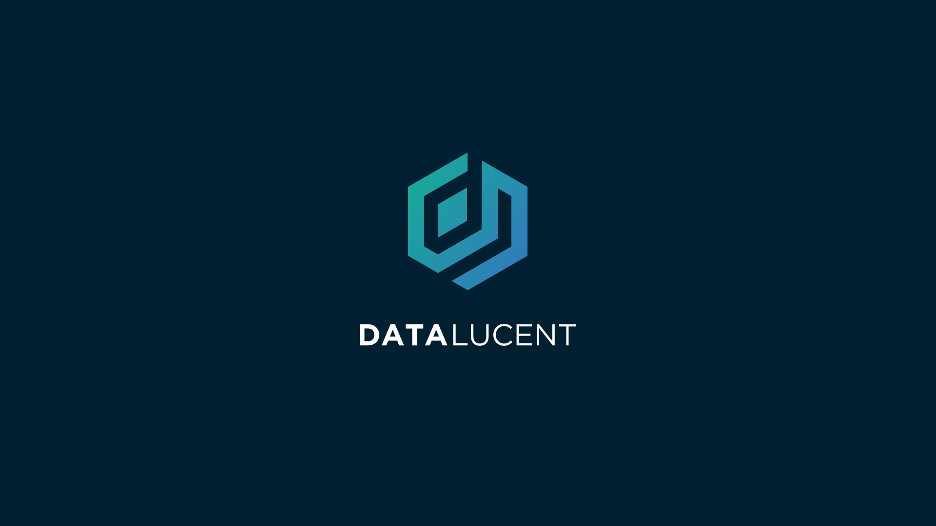

Slide 2


Hello! My name is Beth!
Welcome to DataLucent!

Slide 3


DataLucent will ask for your Google username and password in order to facilitate the data exchange.
Your password will be stored in an encrypted key, that no one else can access, just like a standard password manager.
DATA ACCESS KEY
Username
DATA ACCESS KEY
Password

Slide 4
No one at DataLucent will ever see your password, not even me!

Slide 5

With your data access key, our automated system can access your Google account, without anyone needing to know your information.

Slide 6
Using the special access key, our system will request your data file.

Slide 7
Once your file is requested, the system waits for it to be ready. When it is ready, the system downloads the file to a secure database.

Slide 8
We won’t have access to your Google account or be able to use your credentials again unless you resubmit them.
After the file is downloaded, your credentials are deleted, and the storage container is destroyed.

Slide 11


Slide 12
DataLucent will ask for your Google username and password in order to facilitate the data exchange.
DATA ACCESS KEY
Username
Password

Slide 14
When the file is ready, I will then use the same key to download your file into your personal storage vault.

Slide 15
Once the process is completed, we delete

